Slide 1
Operating Systems
Chapter 4b
Threads
Hammad Afzal
hammad.afzal@mcs.edu.pk
Department of Computer Software Engineering
National University of Sciences and Technology

Slide 2
Roadmap
Overview
Multithreading Models
Thread Libraries

Slide 3
User & Kernel Threads
Support for threads may be provided either at user level or kernel level.
User threads are supported above kernel and managed without kernel support.
Kernel threads are supported by OS.
Thread management done by user-level threads library

Slide 4
User & Kernel Threads
User Level Thread (ULT)
Kernel level Thread (KLT) also called:
kernel-supported threads
lightweight processes.
Three primary User Level thread libraries:
POSIX Pthreads
Win32 threads
Java threads

Slide 5
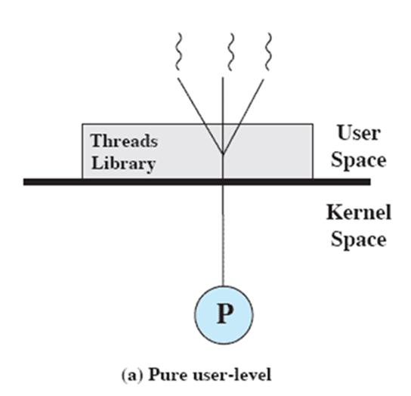
User-Level Threads
All thread management is done by the application
The kernel is not aware of the existence of threads

Slide 6
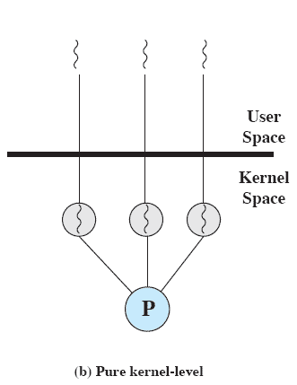
Kernel-Level Threads
Kernel maintains context information for the process and the threads
No thread management done by application
Scheduling is done on a thread basis
Windows is an example of this approach
Notes:
The kernel maintains context information for the process as a whole and for individual threads within the process.
Scheduling by the kernel is done on a thread basis.
-

Slide 7
Advantages of KLT
The kernel can simultaneously schedule multiple threads from the same process on multiple processors.
If one thread in a process is blocked, the kernel can schedule another thread of the same process.
Kernel routines themselves can be multithreaded.

Slide 8
Disadvantage of KLT
The transfer of control from one thread to another within the same process requires a mode switch to the kernel

Slide 9
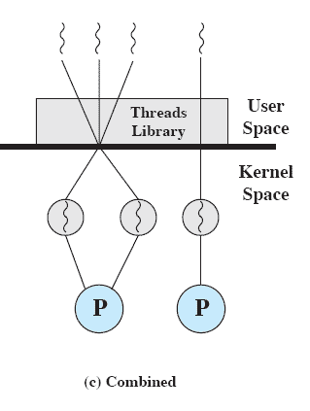
Combined Approaches
Thread creation done in the user space
Bulk of scheduling and synchronization of threads by the application
Example is Solaris
Notes:
In a combined approach, multiple threads within the same application can run in parallel on multiple processors,
and a blocking system call need not block the entire process.
If properly designed, this approach should combine the advantages of the pure ULT and KLT approaches while minimizing the disadvantages.

Slide 10
Multithreading Models
Many-to-One
Similar to the topic “User Level Threads”
One-to-One
Similar to the topic “Kernel Level Threads”
Many-to-Many
Similar to the topic “Combined Approach”

Slide 11
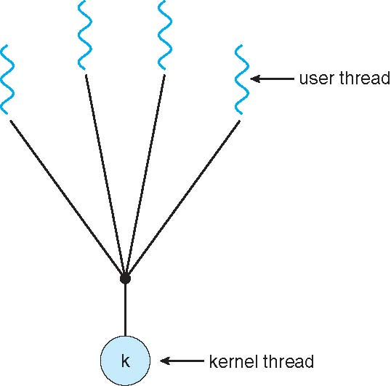
Many-to-One Model

Slide 12
Many-to-One
Many user-level threads mapped to single kernel thread
Thread management done in user space by thread library.
Entire process blocks if a thread makes a blocking system call.
Only one thread can access kernel at a time, multiple threads are unable to run in parallel on multiprocessors.
Examples:
Solaris Green Threads, GNU Portable Threads

Slide 13
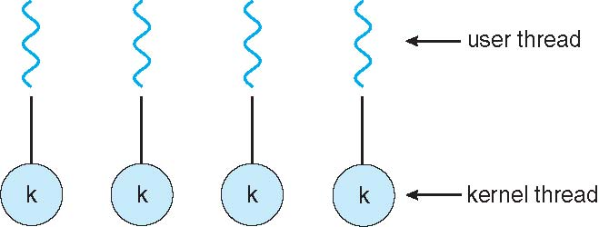
One-to-one Model

Slide 14
One-to-One
Each user-level thread maps to kernel thread.
More concurrency than Many-to-One.
Another thread can run if one thread makes a blocking call.
Multiple threads to run in parallel on multiprocessors.
Drawback:
Creating a user thread requires creating a kernel thread.
Examples
Windows NT/XP/2000, Linux, Solaris 9 and later

Slide 15
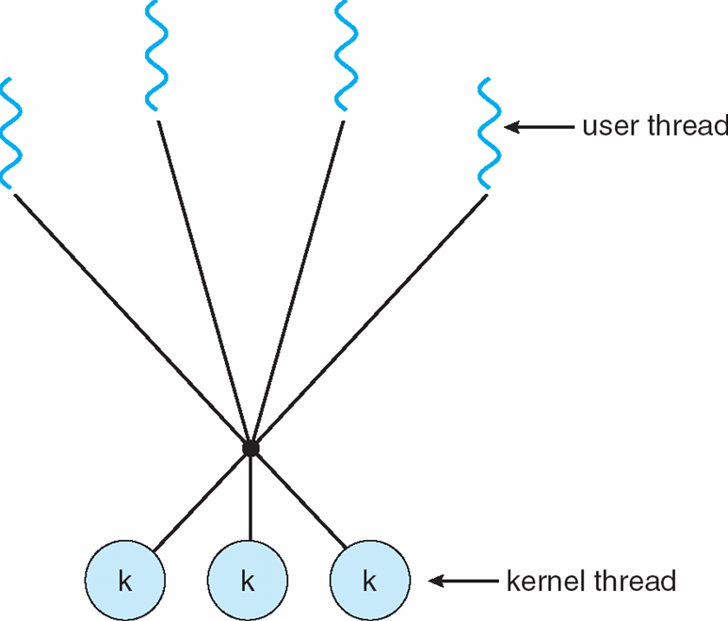
Many-to-Many Model

Slide 16
Many-to-Many Model
Allows many user level threads to be mapped to many kernel threads (equal or smaller number)
Allows the OS to create a sufficient number of kernel threads
Number of kernel threads may be specific to either a particular application or a particular machine.
Solaris prior to version 9, Windows NT/2000 with the ThreadFiber package.

Slide 17
Many to Many Model Vs Other Models
True concurrency not available in Many-to-One.
Kernel can schedule only one thread at a time.
One to one model allows for greater concurrency.
Developer has to be careful about creating too many threads.
Many to many model doesn’t suffer from the issues above.
Developer can create as many threads as necessary and corresponding kernel threads can run in parallel.
When a thread performs a blocking system call, the kernel can schedule another thread.

